Slide 1
Introduction To Cryptography
STREAM CIPHERS –RC4: PUBLIC KEY CRYPTOSYSTEMS

Slide 2
STREAM CIPHERS –RC4: PUBLIC KEY CRYPTOSYSTEMS
For more than 2,000 years, encrypted communication required that the two communicating parties share a common secret
  —the symmetric key used for encryption and decryption
As a matter of fact, the encryption algorithms we have discussed so far have all been symmetric encryption algorithms,
  requiring that both the sender and receiver have knowledge of the key.
But to do so requires (presumably secure) communication.
It is now possible for two parties to communicate with encryption without having a shared secret key that is known in advance.
In 1976, Diffie and Hellman demonstrated an algorithm (known now as Diffie-Hellman Key Exchange) to do just that—
a radically different approach toward secure communication that has led to the development of today’s public key cryptography systems.

Slide 3
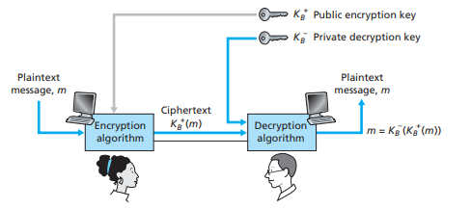
STREAM CIPHERS –RC4: PUBLIC KEY CRYPTOSYSTEMS
In a public key system, the encryption key for messages to go to a particular receiver is broadcast to everyone,
  but the decryption key cannot be derived from it and is known only by the receiver.

Slide 4
STREAM CIPHERS –RC4: PUBLIC KEY CRYPTOSYSTEMS
The use of public key cryptography is conceptually quite simple. Rather than Bob and Alice sharing a single secret key, Bob instead has two keys
—a public key that is available to everyone in the world (including Trudy the intruder) and a private key that is known only to Bob.
In order to communicate with Bob, Alice first fetches Bob’s public key.
Alice then encrypts her message, m, to Bob using Bob’s public key and a known( standardized) encryption algorithm;
Bob receives Alice’s encrypted message and uses his private key and a known decryption algorithm to decrypt Alice’s encrypted message.
there are encryption/ decryption algorithms and techniques for choosing public and private keys such that

Slide 5
STREAM CIPHERS –RC4: PUBLIC KEY CRYPTOSYSTEMS
that is, applying Bob’s public key, to a message, m and then applying Bob’s private key to the encrypted version of m gives back m.
In this manner, Alice can use Bob’s publicly available key to send a secret message to Bob without either of them having to distribute any secret keys
The use of public key cryptography is thus conceptually simple. But two immediate problems arise.
A first concern is that although an intruder intercepting Alice’s encrypted message will see only gibberish,
the intruder knows both the key (Bob’s public key) and the algorithm that Alice used for encryption.
Trudy can thus mount a chosen-plaintext attack, using the known standardized encryption algorithm
and Bob’s publicly available encryption key to encode any message she chooses!

Slide 6
STREAM CIPHERS –RC4: PUBLIC KEY CRYPTOSYSTEMS
if public key cryptography is to work, key selection and encryption/decryption must be done in such a way that
  It is impossible for an intruder to either determine Bob’s private key or somehow otherwise decrypt or guess Alice’s message to Bob.
A second concern is that since Bob’s encryption key is public, anyone can send an encrypted message to Bob, claiming to be Alice.
In the case of public key cryptography, anyone can send an encrypted message to Bob using Bob’s publicly available key.
  A digital signature, is needed to bind a sender to a message.
RSA
The most common public key encryption algorithm is RSA, named for its developers, Ron Rivest, Adi Shamir, and Len Adleman at MIT ,
  is based on results from the field of mathematics known as number theory.

Slide 7
STREAM CIPHERS –RC4: PUBLIC KEY CRYPTOSYSTEMS
A prime number is an integer greater than 1 that can only be written as the product of itself and 1.
For example, 2, 3, 5, 7, 11, . . . are prime numbers; you can only write 7, for example, as 7 = 1 X 7, the product of 1 and 7
The numbers 4, 6, 8, 10, and 12, for example, are not prime because they can be factored in a nontrivial way:
The success of RSA encryption depends on the fact that it is extremely difficult to find the prime factors for n if n is a large number.
So although information encrypted using RSA is technically not secure,
it is secure in practice because of the large amount of computation necessary to find the prime factors of the encoding key.

Slide 8
STREAM CIPHERS –RC4: PUBLIC KEY CRYPTOSYSTEMS
RSA makes extensive use of arithmetic operations using modulo-n arithmetic.
In mathematics, modular arithmetic is a system of arithmetic for integers, where numbers "wrap around" when reaching a certain value, called the modulus.
The modern approach to modular arithmetic was developed by Carl Friedrich
A familiar use of modular arithmetic is in the 12-hour clock, in which the day is divided into two 12-hour periods.
If the time is 7:00 now, then 8 hours later it will be 3:00. Simple addition would result in 7 + 8 = 15, but clocks "wrap around" every 12 hours.
Because the hour number starts over at zero when it reaches 12, this is arithmetic modulo 12.
In terms of the definition below, 15 is congruent to 3 modulo 12, so "15:00" on a 24-hour clock is displayed "3:00" on a 12-hour clock. (Note that here one number is congruent to two numbers)

Slide 9

STREAM CIPHERS –RC4: PUBLIC KEY CRYPTOSYSTEMS
Congruence
Given an integer n > 1, called a modulus, two integers a and b are said to be congruent modulo n, if n is a divisor of their difference
  that is, if there is an integer k such that a − b = kn.
Note that here two numbers are congruent to one number
Congruence modulo n is a congruence relation, meaning that it is an equivalence relation that is compatible with the operations of addition, subtraction, and multiplication. Congruence modulo n is denoted:
The parentheses mean that (mod n) applies to the entire equation, not just to the right-hand side

Slide 10

STREAM CIPHERS –RC4: PUBLIC KEY CRYPTOSYSTEMS
This notation is not to be confused with the notation b mod n (without parentheses), which refers to the modulo operation.
The modulo operation returns the remainder or signed remainder of a division, after one number is divided by another (called the modulus of the operation).
The congruence relation may be rewritten as
what the statement a ≡ b (mod n) asserts is that a and b have the same remainder when divided by n.
Examples
In Modulus 12 one can asset that
because 38 − 14 = 24, which is a multiple of 12. Another way to express this is to say that both 38 and 14 have the same remainder 2, when divided by 12.

Slide 11
STREAM CIPHERS –RC4: PUBLIC KEY CRYPTOSYSTEMS
Here’s how RSA works. Two large prime numbers p and q are chosen at − random, and their product n = p X q is computed.
The product m = (p - 1) X (q - 1) is also computed.
Next, a large random number e is chosen in such a way that e less than n and has no common factors with m other than 1.
This step guarantees the existence of a unique integer d between 0 and m, such that whenever we reach m, we start over again counting from 0— the result is 1.
There are computationally efficient ways to produce p, q, e, and d.

Slide 12
STREAM CIPHERS –RC4: PUBLIC KEY CRYPTOSYSTEMS
Choose two large prime numbers p & q
Compute n=pq and m=(p-1)(q-1)
Choose number e, less than n, which has no common factor (other than 1) with m
Find number d, such that ed – 1 is exactly divisible by m
Keys are generated using n, d, e
  Public key is (n,e)
  Private key is (n, d)
Encryption: c = m^{e} mod n
  m is plain text
  c is cipher text
Decryption: m = c^{d} mod n
Public key is shared and the private key is hidden

Slide 13

STREAM CIPHERS –RC4: PUBLIC KEY CRYPTOSYSTEMS
For example, suppose we pick p = 3 and q = 7
Now the number pair (n, e) becomes the public encryption key, and (n,d) is the decryption key.
Let’s suppose that the plaintext message has been converted into an integer P

Slide 14
STREAM CIPHERS –RC4: PUBLIC KEY CRYPTOSYSTEMS
The encryption process is to compute P^e using wraparound arithmetic with respect to n
. Continuing with our example, suppose P = 3. Then the ciphertext is computed as
Note that the sender uses both parts of the public key, e and n, to compute the ciphertext
) The receiver decodes the ciphertext C by computing C ^d using wraparound arithmetic with respect to n. In our example,
The whole point is that even though n and e are known, the attacker must determine d, which involves finding the prime factors p and q of n.
There is no known computationally efficient algorithm for this task.

Slide 15
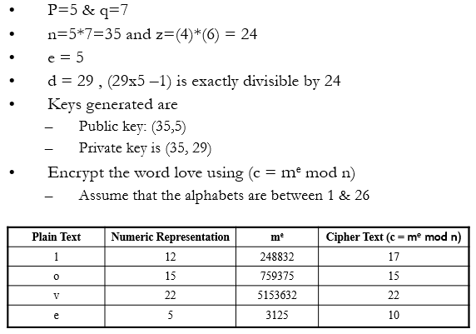
STREAM CIPHERS –RC4: PUBLIC KEY CRYPTOSYSTEMS
Another example is shown below.

Slide 16
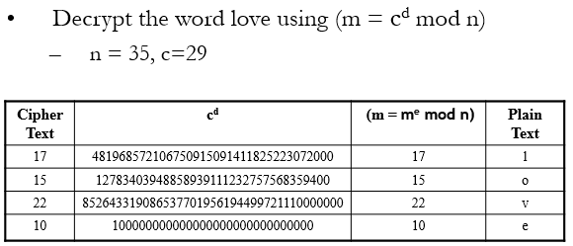
STREAM CIPHERS –RC4: PUBLIC KEY CRYPTOSYSTEMS
RSA Decryption

Slide 17
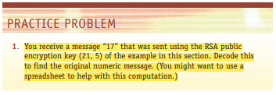
STREAM CIPHERS –RC4: PUBLIC KEY CRYPTOSYSTEMS QUIZ 2

Slide 18
STREAM CIPHERS –RC4: PUBLIC KEY CRYPTOSYSTEMS
RC4
RC4 means Rivest Cipher 4 invented by Ron Rivest in 1987 for RSA Security. It encrypts messages one byte at a time via an algorithm.
It is a Stream Cipher. RC4 stream cipher is one of the most widely used stream ciphers because of its simplicity and speed of operation.
It is a variable key-size stream cipher with byte-oriented operations.
It uses either 64 bit or 128-bit key sizes. It is generally used in applications such as
  Secure Socket Layer (SSL), Transport Layer Security (TLS), and also used in IEEE 802.11 wireless LAN std.
RC4 Encryption Procedure
1. The user inputs a plain text file and a secret key.
2. The encryption engine then generates the keystream by using KSA and PRGA Algorithm.

Slide 19
STREAM CIPHERS –RC4: PUBLIC KEY CRYPTOSYSTEMS
3. This keystream is now XOR with the plain text, this XORing is done byte by byte to produce the encrypted text.
4. The encrypted text is then sent to the intended receiver, the intended receiver will then decrypted the text and after decryption, the receiver will get the original plain text.
Decryption Procedure
Decryption is achieved by doing the same byte-wise X-OR operation on the Ciphertext.
Advantages
RC4 stream ciphers are simple to use.
The speed of operation in RC4 is fast as compared to other ciphers.

Slide 20
STREAM CIPHERS –RC4: PUBLIC KEY CRYPTOSYSTEMS
RC4 stream ciphers are strong in coding and easy to implement.
RC4 stream ciphers do not require more memory.
RC4 stream ciphers are implemented on large streams of data.
Disadvantages
RC4 stream ciphers do not provide authentication.
RC4 algorithm requires additional analysis before including new systems.
RC4 stream ciphers cannot be implemented on small streams of data.
RC4 fails to discard the beginning of output keystream or fails to use non-random or related keys for the algorithm.

Slide 21
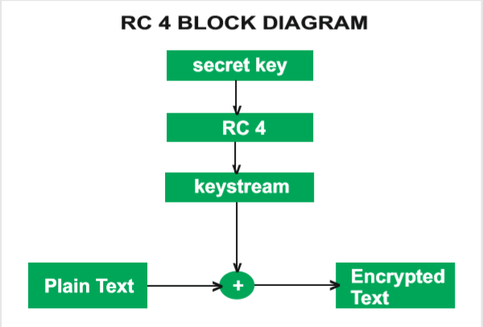
STREAM CIPHERS –RC4: PUBLIC KEY CRYPTOSYSTEMS

Slide 22
STREAM CIPHERS –RC5: SYMETRIC KEY CRYPTOSYSTEMS
RC5
RC5 is a symmetric key block encryption algorithm designed by Ron Rivest in 1994.
It is notable for being simple, fast (on account of using only primitive computer operations like XOR, shift, etc.) and consumes less memory.
RC5 is a block cipher and addresses two word blocks at a time.
Depending on input plain text block size, number of rounds and key size, various instances of RC5 can be defined and each instance is denoted as RC5-w/r/b
  where w=word size in bits, r=number of rounds and b=key size in bytes.
In RC5, the plain text message is divided into two blocks A and B each of 32 bits. Then two subkeys are generated S[0] and S[1]. These two subkeys are added into A and B respectively.

Slide 23
STREAM CIPHERS –RC4: PUBLIC KEY CRYPTOSYSTEMS
This process produces C and D respectively and marks the end of the one-time operation.
Then the process of the round begins. In each round, the following operation is performed.
Bitwise XOR.
Left circular shift.
addition to the next subkey, for both C and D. This, is the addition operation, and then the result of the addition mod 2^w is performed.
The encryption routine is based on three primitive operations: integer addition, bitwise XOR- (exclusive-or) and variable rotation operations.
Bitwise XOR operator is also known as Exclusive OR

Slide 24
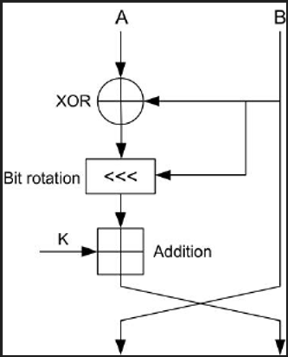
STREAM CIPHERS –RC4: PUBLIC KEY CRYPTOSYSTEMS

Slide 25
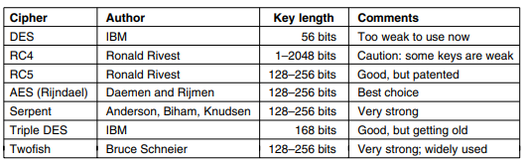
STREAM CIPHERS –RC4: PUBLIC KEY CRYPTOSYSTEMS
Other Ciphers

